Slide 1
Task 2
Netsparker found vulnerabilities

Slide 2
1) Vulnerability found- OUT OF DATA VERSION (Open SSL)
REPORT
URL- https.//zero.webappsecurity.com
Netsparker identified that the website uses out of device version of open SSL
The version is identified with 5 critical and 107 other vulnerabilities
Since the version of this software is outdated it is more vulnerable to the attacks
To overcome this its adviced to update the version to its latest version
Following are the other type of vulnerabilities found in this version
OpenSSL Resource Management Errors Vulnerability
OpenSSL Cryptographic Issues Vulnerability
OpenSSL Improper Authentication Vulnerability
OpenSSL Resource Management Errors Vulnerability
OpenSSL Improper Input Validation Vulnerability

Slide 3
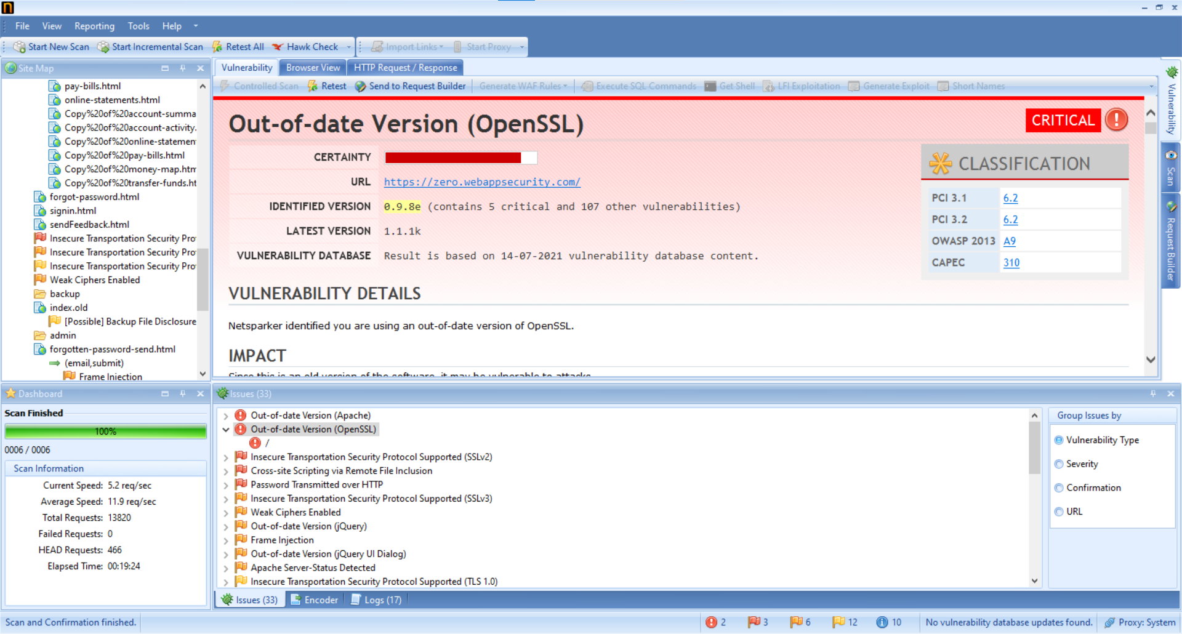

Slide 4
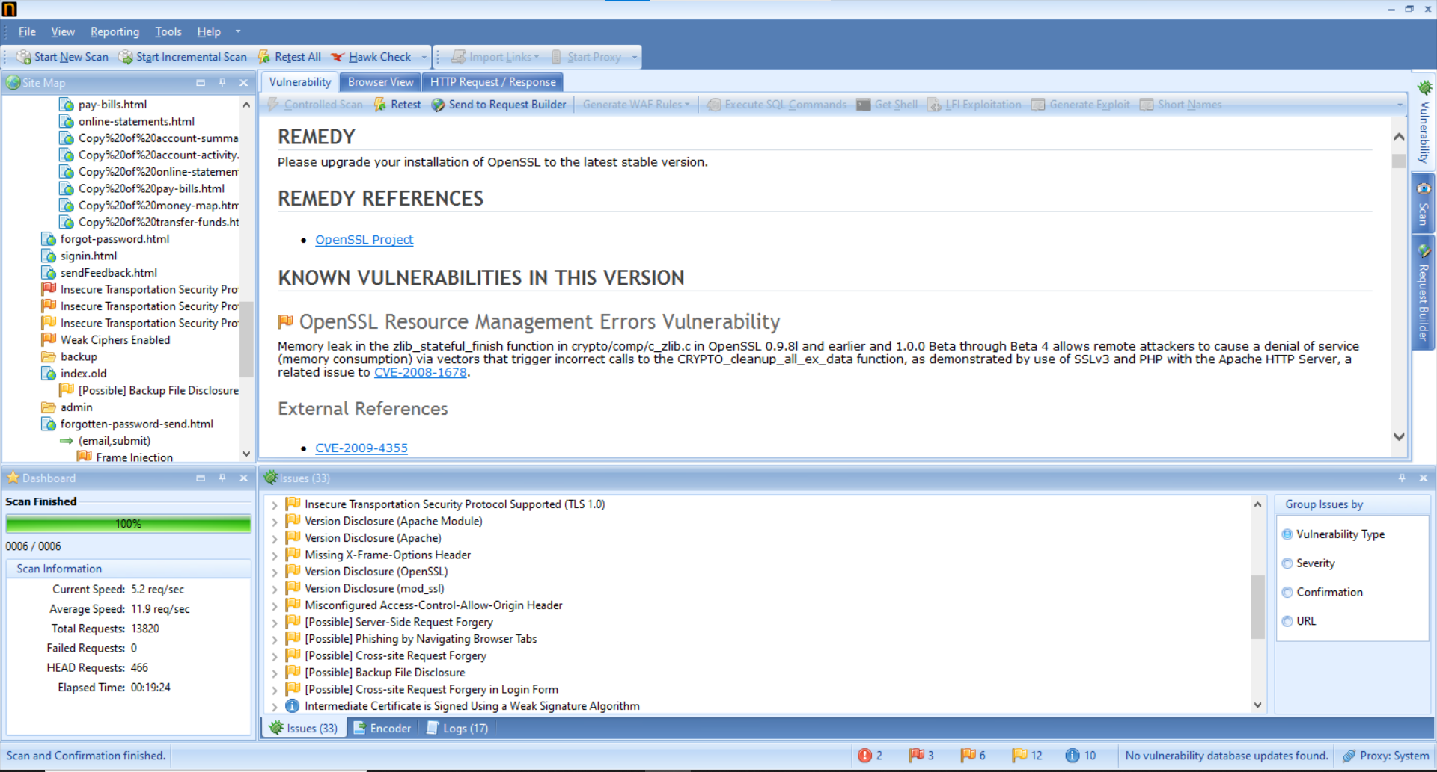

Slide 5
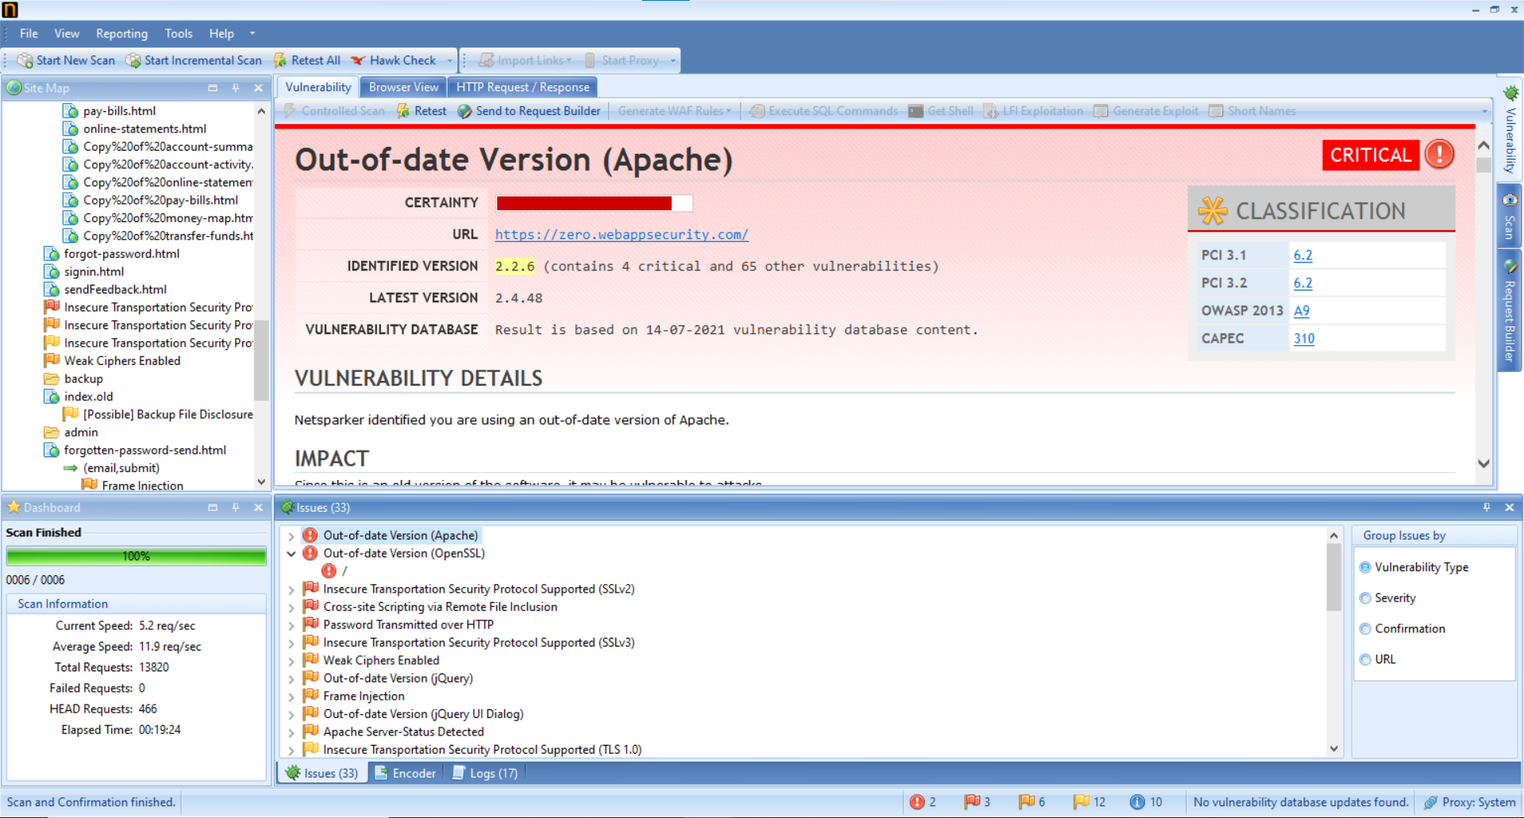
2) Vulnerability found- OUT OF DATA VERSION (Apache)

Slide 6
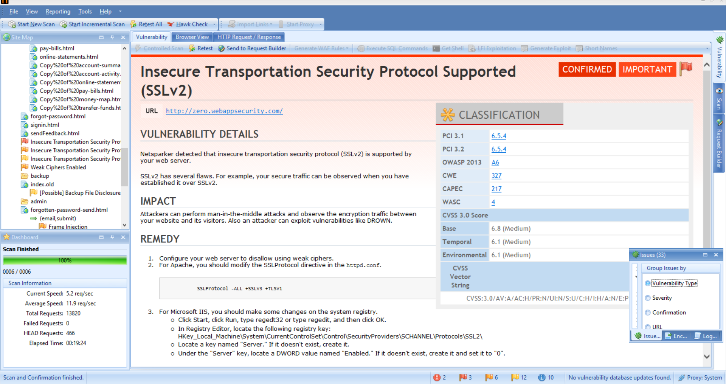
3)Vulnerability found-Insecure Transportation Security Protocol Supported (SSLv2)

